Slide 1

Project 4
MAC Layer
Buffer Status Reporting (BSR)
Notes:
https://pixabay.com/illustrations/ai-generated-waves-abstract-8610723/
https://pixabay.com/photos/business-corporate-designer-artist-7607421/

Slide 2

BSR
What is BSR , role in 5G
BSR Mechanism
BSR Types and roles
BSR types, roles in uplink scheduling
BSR Effect on Uplink Scheduling and Resource Allocation
Table of Content
Code
Output
Notes:
https://pixabay.com/photos/ux-prototyping-design-webdesign-788002/

Slide 3
About Project

Slide 4
About Project
5.4.5 of 3GPP 38.321
Buffer Status Reporting (BSR) is a critical mechanism in the MAC layer of 5G networks that provides the network with information about the amount of data in a User Equipment's (UE) buffer. This project focuses on simulating the BSR process within a 5G environment to understand its impact on uplink scheduling.
Objectives:
Develop a C++ program to simulate BSR and assess its influence on uplink scheduling.
Understand the various types of BSR and their roles in managing uplink data transmission.
Notes:
https://pixabay.com/photos/graphics-tablet-drawing-laptop-4570796/
https://pixabay.com/photos/rain-water-raindrops-droplets-5470471/

Slide 5
Group Members
Mentor/Guide: Abhijeet Kumar
Rajeshwari
Swetav
Sujata
Pavan
Prasad
Shashwat
Bhuvaneshwari

Slide 6
Introduction to BSR (Buffer Status Report)

Slide 7
What is BSR
5.4.5 of 3GPP 38.321
A UE uses Buffer Status Reporting (BSR) to provide the Base Station within information regarding the volume of uplink data waiting to be transferred. Buffer Status Reports are sent on the PUSCH using a MAC Control Element. The provision of a Buffer Status Report helps the Base Station to allocate an appropriate quantity of air-interface resources.
Both the PDCP and RLC layers provide the MAC layer with data volume figures so the UE is able lo signal the total buffered data volume to the Base Station
RRC configures the following parameters to control the BSR:
periodicBSR-Timer;
retxBSR-Timer;
logicalChannelSR-DelayTimerApplied;
logicalChannelSR-DelayTimer;
logicalChannelSR-Mask;
logicalChannelGroup;
sdt-LogicalChannelSR-DelayTimer.
Buffer Status Reports are sent per 'Logical Channel Group' (LCG) rather than per 'Logical Channel' (although it is possible for an LCG to include only a single Logical Channel). In general, Logical Channels with similar priority are linked to the same LCG. This allows the Base Station to differentiate between the volume of high priority data and the volume of lower priority data.
Notes:
https://pixabay.com/photos/graphics-tablet-drawing-laptop-4570796/
https://pixabay.com/photos/rain-water-raindrops-droplets-5470471/

Slide 8
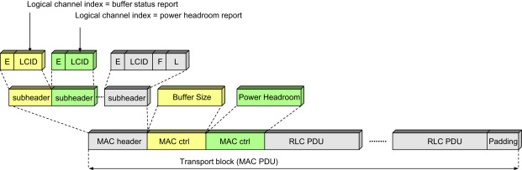
What is BSR
Fig 1.1 Structure of MAC PDU with Buffer Status and Power Headroom Reports
Notes:
https://pixabay.com/photos/graphics-tablet-drawing-laptop-4570796/
https://pixabay.com/photos/rain-water-raindrops-droplets-5470471/

Slide 9
Role of BSR in 5G
3GPP 38.321
Indicating Buffer Status: The BSR is used by a User Equipment (UE) to inform the eNodeB (for LTE) or gNodeB (for 5G) about the amount of data that is waiting to be transmitted. This helps the network determine the appropriate amount of resources to allocate for data transmission.
Resource Allocation: By sending a BSR, the UE can request scheduling resources to transmit the data stored in its buffer. This helps ensure that the data is transmitted in a timely manner, optimizing the use of network resources and improving the efficiency of data transmission.
Scheduling Requests: The BSR is an important component in scheduling requests. The network uses the information from the BSR to schedule when and how much data the UE can transmit. This scheduling is crucial for maintaining efficient and balanced network operation.
Priority Handling: The BSR also helps in handling priority data. Different types of data (e.g., high-priority voice calls vs. low-priority background data) might be managed differently based on the buffer status information.
Notes:
https://pixabay.com/photos/graphics-tablet-drawing-laptop-4570796/
https://pixabay.com/photos/rain-water-raindrops-droplets-5470471/

Slide 10
BSR Mechanism in MAC Layer

Slide 11
BSR Mechanism
5.4.5 of 3GPP 38.321
Data Arrival at UE Buffer: When new data arrives in the UE’s buffer, it may trigger a BSR to inform the base station that the UE has data to send.
Periodic Reporting: Some UEs may be configured to send BSRs at regular intervals, regardless of buffer changes, to ensure the base station has up-to-date information.
Retransmission of BSR: If a previously sent BSR was not acknowledged, the UE might retransmit the BSR to ensure the base station is aware of the current buffer status.
Change in Buffer Status: Significant changes in the buffer status, such as data being removed or added, can also trigger a BSR.

Slide 12
Types of BSR and their Roles

Slide 13
Types of BSR & its Roles
5.4.5 of 3GPP 38.321
There are different types of BSRs that UEs can send:
Regular BSR: Indicates the current status of the buffer for one or more logical channels. It's typically sent when there is new data in the buffer that hasn't been reported yet.
Periodic BSR: Sent at regular intervals to update the base station on the buffer status, even if there is no new data.
Padding BSR: Sent when there is a small amount of padding space available in the uplink data transmission, and the UE uses it to send a BSR.

Slide 14
Types of BSR
5.4.5 of 3GPP 38.321
There are three categories of triggering mechanism for Buffer Status Reports (BSR):
Regular BSR triggering is applicable if:
new uplink data becomes available for transmission, and that uplink data belongs to a Logical Channel which has higher priority than the Logical Channels associated with the previously available uplink data
new uplink data becomes available for transmission after having no uplink data available for transmission
the retxBSR-Timer expires when there is uplink data waiting to be transferred. The retxBSR-Timer has been specified to help avoid the deadlock situation which occurs when the Base Station fails to receive a Buffer Status Report while the UE believes that reception has been successful, i.e. the UE fails to receive the request for a re-transmission.
Periodic BSR triggering is applicable if:
The periodicBSR-Timer expires. This timer can be set to 'infinity' so periodic Buffer Status Reports are optional. The periodic timer is re-started after each Buffer Status Report transmission unless the 'truncated' report format is used.
Padding BSR triggering is applicable if:
uplink resources have been allocated such that the number of padding bits equals or exceeds the size ofa Buffer Status Report. In this case, a Buffer Status Report is included within the uplink packet to reduce the quantity of padding, i.e. taking advantage of the unused uplink capacity
The Regular BSR and the Periodic BSR shall have precedence over the padding BSR.
Notes:
https://pixabay.com/photos/graphics-tablet-drawing-laptop-4570796/
https://pixabay.com/photos/rain-water-raindrops-droplets-5470471/

Slide 15
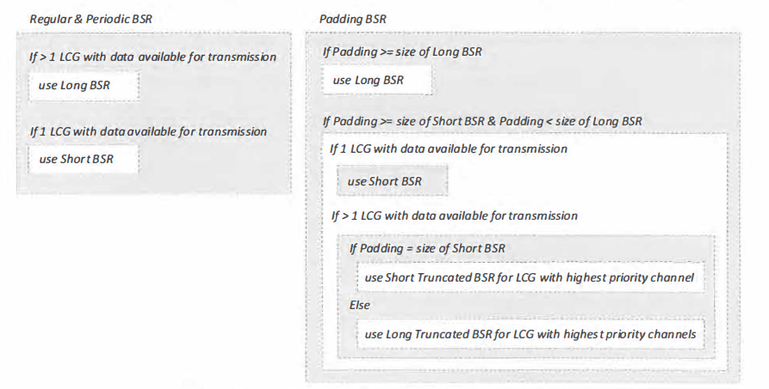
BSR Mechanism
5.4.5 of 3GPP 38.321
Fig 2.1 Selection between the four Buffer Status Report formats
Notes:
https://pixabay.com/photos/graphics-tablet-drawing-laptop-4570796/
https://pixabay.com/photos/rain-water-raindrops-droplets-5470471/

Slide 16
Role of BSR in Uplink Scheduling
3GPP 38.321
The Buffer Status Report (BSR) is essential in uplink scheduling within mobile networks like 4G and 5G. It allows User Equipment (UE) to communicate the status of its data buffer to the base station (gNodeB in 5G or eNodeB in 4G). Here's how BSR influences uplink scheduling:
Resource Request: The UE uses BSR to inform the base station about the amount of data waiting in its buffer to be transmitted. This information is critical for the base station to understand the UE's data transmission needs.
Scheduling Decisions: The base station's scheduler uses the BSR information to decide how much uplink bandwidth to allocate to each UE. UEs with more data in their buffers (as indicated by BSR) are prioritized to ensure timely data transmission.
Efficient Resource Allocation: BSR helps the base station allocate resources efficiently by dynamically adjusting the uplink grants based on real-time buffer statuses. This ensures that UEs with urgent or large data -transmission requirements receive the necessary resources.
Quality of Service (QoS): BSR plays a role in maintaining the QoS for different services. UEs transmitting high-priority data (like voice or video) can be given preferential treatment based on their BSR, ensuring that critical data is sent with minimal delay.
Network Load Balancing: By analyzing BSRs from multiple UEs, the base station can balance the load across the network. This prevents congestion and ensures fair resource distribution among UEs.

Slide 17
BSR Effects on Uplink Scheduling & Resource Allocation

Slide 18
How BSR affects the scheduling and resource allocation in the uplink
3GPP 38.321​
Impact on Uplink Scheduling
The base station uses the information from BSR to make informed decisions about resource allocation. This includes:
Prioritizing UEs: UEs with higher buffer statuses may be given more resources to prevent buffer overflow and ensure timely data transmission.
Dynamic Scheduling: The base station dynamically adjusts the uplink scheduling based on real-time buffer status reports from multiple UEs.
Optimizing Network Performance: By efficiently allocating resources based on BSR, the network can optimize performance, reduce latency, and improve overall service quality.

Slide 19
3GPP 38.321​
Impact on Resource Allocation
Resource Allocation:
Based on the BSR, the base station allocates uplink resources (e.g., time slots, frequency resources) to the UE. The allocation is made considering the amount of data reported in the BSR and the overall network load.
Dynamic Adjustment:
If the buffer status changes (e.g., due to new data arrival or data transmission), the UE may generate a new BSR. The base station can dynamically adjust the resource allocation based on the updated BSR to accommodate the changing traffic conditions.
Avoiding Congestion:
Proper handling of BSR helps avoid uplink congestion by ensuring that UEs with significant amounts of data waiting to be transmitted are given sufficient resources, preventing buffer overflow and data loss.
Efficient Utilization:
Effective BSR handling leads to more efficient utilization of network resources. The base station can optimize the use of available resources based on real-time traffic demands, improving overall network performance.

Slide 20
Code

Slide 21
Code

Slide 22
Output

Slide 23
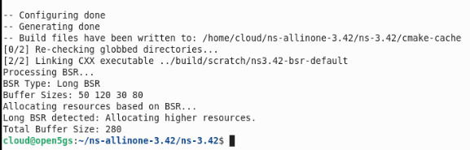
Output

Slide 24
Thank You!

